Slide 1

IT Infrastructure Management Chapter 4: THE ITIL SERVICE VALUE SYSTEM TY B.Sc. (IT)
Semester VI
Poornima .N
Assistant Professor, Department of IT/CS
1

Slide 2

1 Topics:
Service value system overview
Opportunity, demand, and value
The ITIL guiding principles
Governance
Service Value chain
Practice
Continual Improvement

Slide 3

2 Introduction
SVS is the framework showing how an organization works as a system to co-create value.
Inputs → Activities → Outputs = Value
Key components: Guiding principles, Governance, Service Value Chain, Practices, Continual Improvement

Slide 4
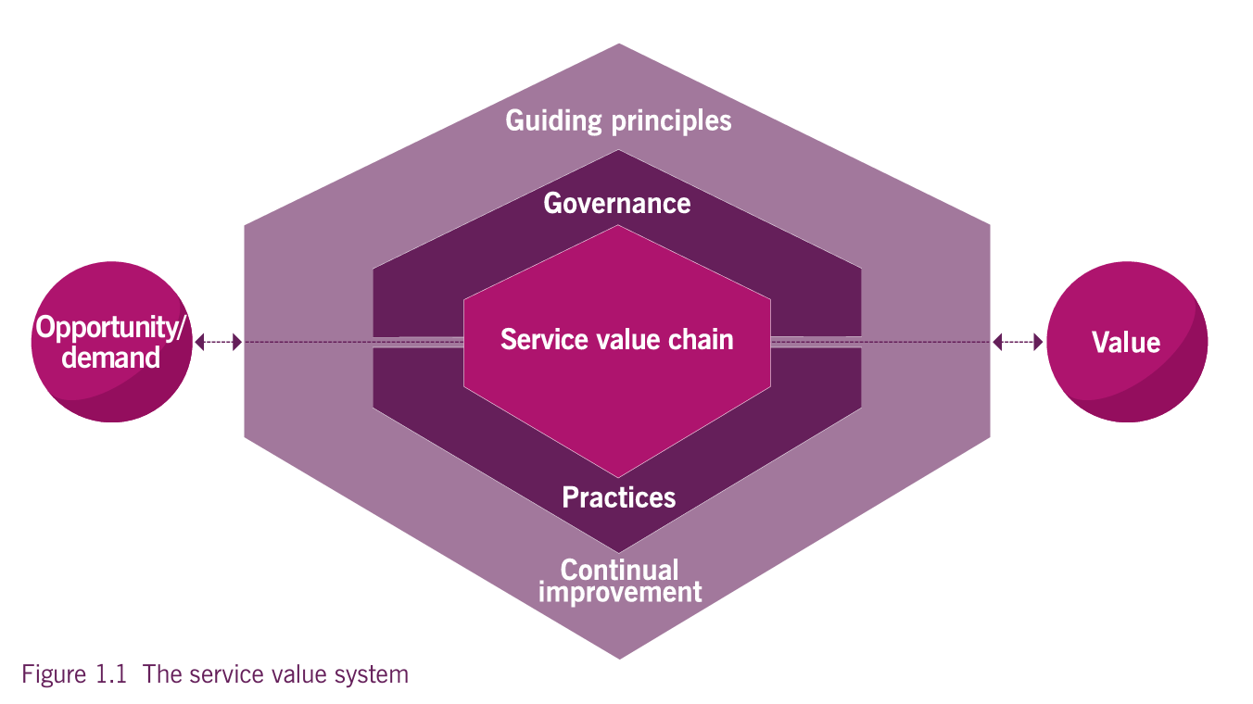
The Core Components of the ITIL SVS
It ensures that all activities in an organization work together to deliver value to

Slide 5
3 Service Value System (SVS) Overview
The ITIL SVS describes how all components and activities of an organization work together as a system to create value.

Slide 6


Slide 7
4 Inputs, Components, Outputs
Inputs: Opportunity & Demand
Components: Governance, SV Chain, Practices, Guiding Principles, Continual Improvement
Outputs: Value for organization, customers, stakeholders

Slide 8
The Core Components of the ITIL SVS
It ensures that all activities in an organization work together to deliver value to

Slide 9
5 Activity 1
Think of a service you use every day—what makes it valuable?

Slide 10
6 Organizational Agility & Resilience
Agility: Ability to adapt quickly internally
Resilience: Ability to handle external changes/disruptions
SVS supports both and enables continuous improvement

Slide 11
7 Opportunity, Demand, and Value
Opportunity and demand trigger activities in the ITIL SVS.
These activities create value.
Organizations do not automatically accept all opportunities or satisfy all demand.

Slide 12
8 What is Opportunity?
Options or possibilities to add value or improve the organization.
Example: Implementing AI analytics before any department requests it.

Slide 13
9 What is Demand?
Need or desire for products and services from internal/external customers.
Example: Customers requesting a faster app update.

Slide 14
10 Relationship to Value How Opportunity and Demand Create Value?
Both enter the SVS and trigger activities.
Activities are designed to maximize stakeholder value.

Slide 15
11 Questions…. For understanding
List the key inputs and the key output of the ITIL Service Value System (SVS).
What is the purpose of the SVS?
Identify the five main components of the ITIL SVS.
What is the difference between opportunity and demand as inputs to the SVS?
"The text states that practices should not be silos. Give an example of how the 'Incident Management' practice might need to interact with the 'Organizational Change Management' practice.“
"A competitor releases a disruptive product, requiring your organization to completely redefine its service offerings quickly. Is this a test of organizational agility or organizational resilience, and why?“
Draw the diagram of SVS

Slide 16
12 The ITIL Guiding Principles: A Universal Foundation for Service Management
"Universal and enduring recommendations that guide an organization in all circumstances."

Slide 17
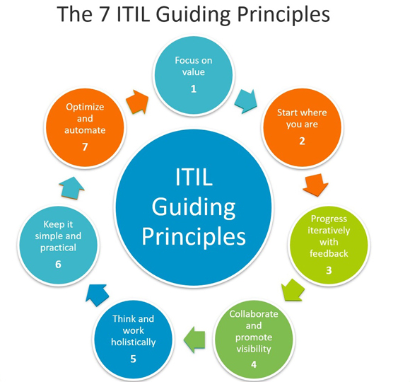

Slide 18


13 Focus on Value
Everything maps to value for stakeholders.
Know your consumer (Customer/User) and their definition of value (CX/UX).

Slide 19

14 Start Where You Are
Do not start from scratch.
Assess the current state objectively.
Re-use, alter, or build upon what exists.
Goodhart's Law:"When a measure becomes a target, it ceases to be a good measure."

Slide 20
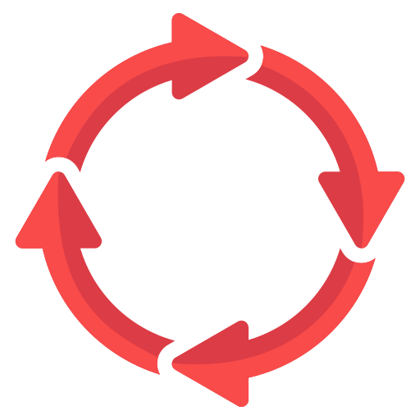
15 Progress Iteratively with Feedback
Work in small, manageable sections.
Embed feedback loops (MVP concept).
Fast does not mean incomplete.

Slide 21

16 Collaborate & Promote Visibility
No service stands alone.
Integrate People, Partners, Practices,
Information, Technology, Organization,
and Agreements to deliver value.

Slide 22

17 Keep it Simple & Practical
Eliminate anything that doesn't provide
value.
Use outcome-based thinking.
Minimum steps required.

Slide 23

18 Optimize & Automate
Use resources to their best effect.
Automate where possible.
Reserve human intervention for
value-adding activity.

Slide 24
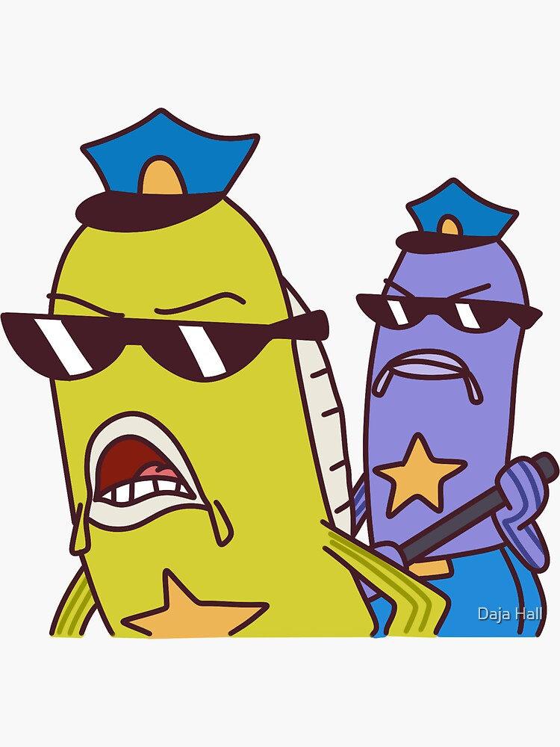
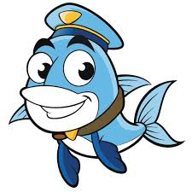
19 FISH COP
Principle | Easy Hook / Meaning
Focus on Value | Focus (Why are we doing this?)
Iterative Progress | Iterate (Test and adjust constantly.)
Start Where You Are | Start (What's our current status?)
Holistic Thinking | Holistic (See the whole system.)
Collaborate | Collaborate (Who needs to be involved?)
Optimize and Automate | Optimize (Make it better and faster.)
Practical and Simple | Practical (Keep it simple.)

Slide 25
20 Governance in the ITIL SVS
Governing bodies and governance
Governance in the SVS

Slide 26
21 What is IT Governance? (VS. IT Management)
IT Governance: The system by which the use of IT is directed and controlled (Board/Executive responsibility). * Focuses on Value, Risk, and Alignment.
* IT Management: Plans, builds, runs, and monitors IT activities (operational responsibility).
* The relationship: Governance asks what and why; Management asks how and when.

Slide 27
22 The Three Core Governance Activities
Three Activities:
Evaluate
Direct
Monitor

Slide 28
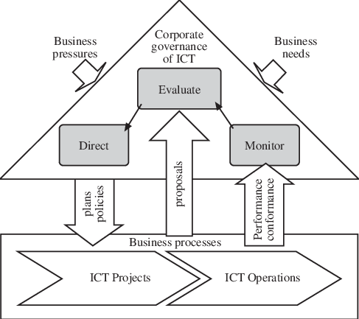
The Evaluate-Direct-Monitor (EDM) Cycle

Slide 29
23 1. Evaluate (E) 🧐
Understand the environment and stakeholder needs.

Slide 30
24 2. Direct (D) 🧭
Guide management to achieve the objectives.

Slide 31
25 3. Monitor (M) 📊
Check adherence and performance against direction

Slide 32
26 ISO/IEC 38500 Principles:
Responsibility: Who is accountable for E, D, and M?
Strategy: Ensuring the Direct phase aligns IT and business.
Acquisition: Guiding the value in IT investments (part of Direct).
Performance: Measuring IT value (part of Monitor).
Conformance: Legal/Regulatory compliance (part of Monitor). * Human Behavior: Considering the people impact (relevant to all three).

Slide 33
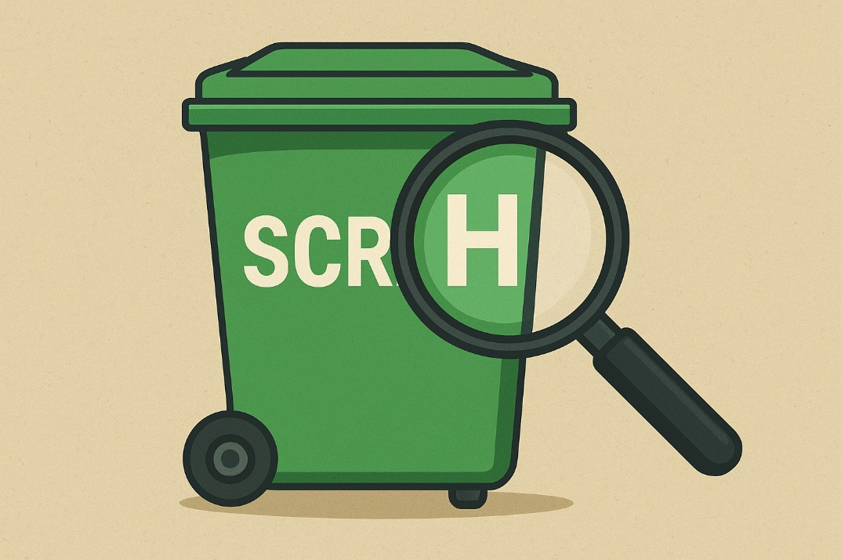
27 ISO/IEC 38500 (6 Principles)
Letter | Principle | Easy Hook / Focus Word
S | Strategy | Strategy (Where are we going?)
C | Conformance | Compliance (Is it legal?)
R | Responsibility | Accountability (Who is in charge?)
A | Acquisition | Investment (Is the cost worth it?)
P | Performance | Value (Is it working?)
H | Human Behavior | Ethics (Is it right?)

Slide 34
28 ISO/IEC 38500 (6 Principles) and ITIL Guiding Principles (7 Principles)
ISO/IEC 38500 Principles (Governance): The principles for the Governing Body (Board/Executives).
ITIL Guiding Principles (Management): The principles for the IT Management Team (Managers/Staff).

Slide 35
29 The ITIL Service Value Chain (SVC)
The Service Value Chain (SVC) is the central operating model in the ITIL SVS. It is a set of six interlinked activities that an organization performs to respond to demand and create value for the consumer through the delivery of products and services.

Slide 36
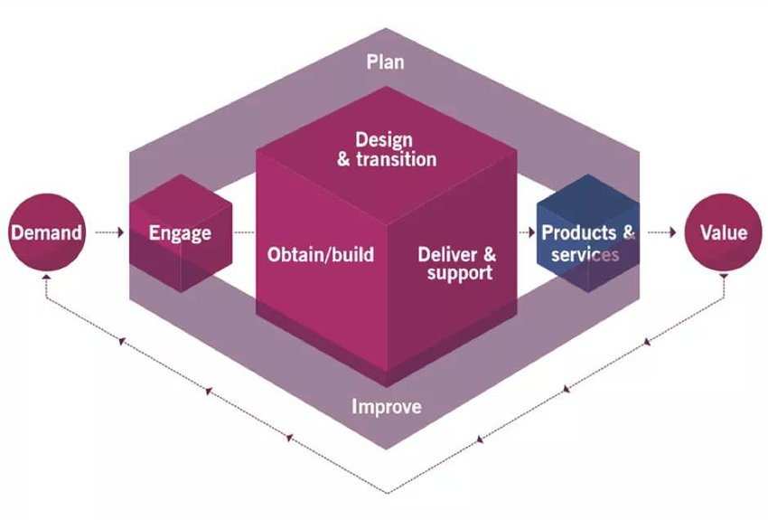

Slide 37

30 Plan
To ensure a shared understanding of the vision, current status, and improvement direction for all four dimensions and all products/services.

Slide 38

31 Engage
To provide a good understanding of stakeholder needs, transparency, continual engagement, and good relationships.

Slide 39
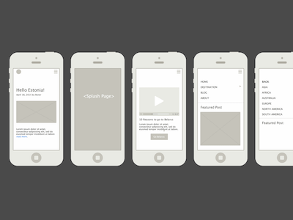
32 Design and Transition
To ensure that products and services continually meet stakeholder expectations for quality, costs, and time to market.

Slide 40

33 Obtain/Build
To ensure that service components (infrastructure, applications, etc.) are available when and where they are needed, and meet agreed specifications.

Slide 41

34 Deliver and Support
To ensure that services are delivered and supported according to agreed specifications and stakeholders' expectations.

Slide 42

35 Improve
To ensure the continual improvement of products, services, and practices across all value chain activities.

Slide 43
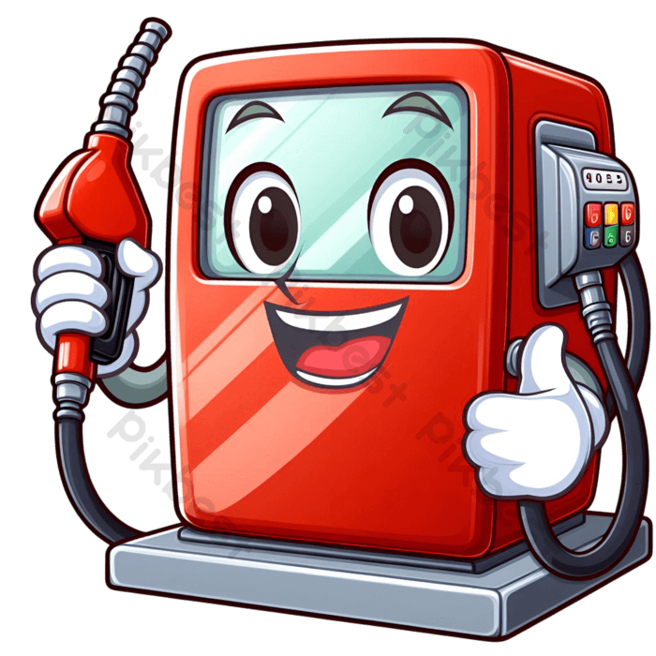
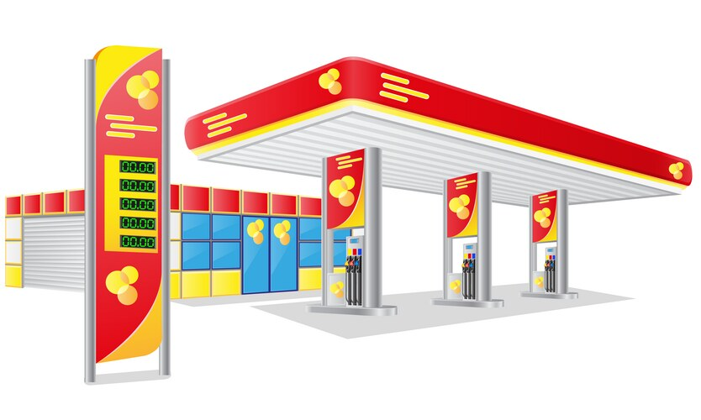
36 PEDODI

Slide 44
37 🚀 Fast Example Flow
Customer says: I want faster delivery. (Engage) Plan makes a strategy. (Plan) Service designed & tested. (Design & Transition) Resources built / bought. (Obtain/Build) Delivery team executes. (Deliver & Support) Feedback collected for future improvements. (Improve)

Slide 45
38 Continual improvement
Happens at all levels – strategic to operational
Everyone must look for improvement opportunities
Applies across the Service Value System and all services
Supported by:
– Continual improvement model
– Improve value chain activity
– Continual improvement practice
Flexible – not always linear, steps may repeat

Slide 46
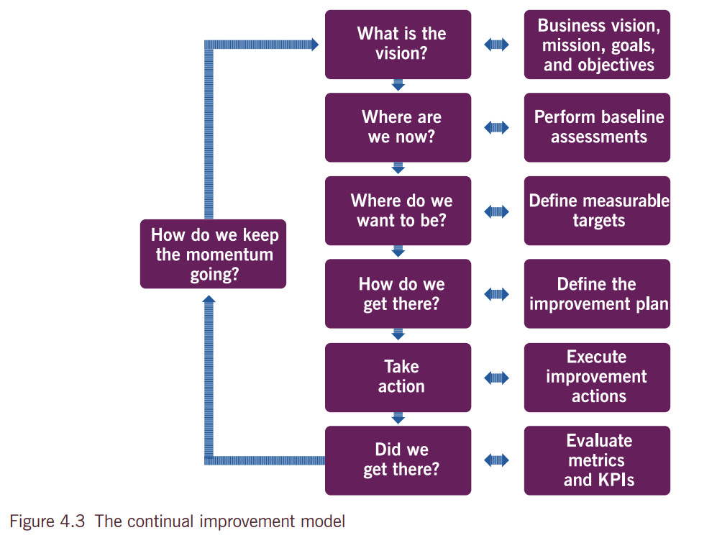

Slide 47
39 What is the Vision?🔭
Define the overall goal of the improvement initiative.
Clarify why the improvement is needed.
Vision

Slide 48
40 Where are we now? 📊
Assess the current state before improving.
Measure baseline performance and capabilities.
Investigate

Slide 49
41 Where do we want to be? 🎯
Define the target state.
Define SMART goals: Specific, Measurable, Achievable, Relevant, Time-bound.
Purpose

Slide 50
42 How do we get there? 🗺️
Plan the route from current state to target.
Identify steps and resources needed to reach goals.
Tactics

Slide 51
43 Take Action ⚡
Execute the improvement plan.
Implement changes according to plan.
Execute

Slide 52
44 Did we get there? ✅
Check if the improvement has achieved its goals.
Identify gaps or adjustments needed.
Analyze

Slide 53
45 How do we keep Momentum going? 🔁
Sustain and embed improvements.
Prepare for next iteration of improvement.
Maintain

Slide 54

Mnemonic Letter | Step Key Word Change | Original Step Concept
V | Vision | Understand the high-level direction.
I | Investigate | Assess the current performance (Where are we now?).
P | Purpose | Define measurable targets (Where do we want to be?).
T | Tactics | Create a plan/strategy (How do we get there?).
E | Execute | Take action/Implement the activities.
A | Analyze | Evaluate the results (Did we get there?).
M | Maintain | Keep the momentum going.

Slide 55
46 VIPTEAM 😎👑
The VIP TEAM steps, applied to launching a new product:
Vision: We aim to be the top-rated product in the market.
Investigate: Assess the current situation: we have 0% market share; competitors offer X, Y, Z features.
Purpose: Our target is to achieve 10,000 users and a 4.5-star rating within six months.
Tactics: Our plan is aggressive social media marketing and a free trial period.
Execute: Launch the product, run all campaigns, and manage the free trial period.
Analyze: Check user count and rating weekly against the 6-month target.
Maintain: If successful, invest in new features (version 2.0) to keep the growth momentum.

Slide 56
47 What is a Practice?
A practice is basically a way of working in the organization.
It includes all the resources (people, tools, processes, information) needed to perform work or achieve a goal.

Slide 57
47 ITIL SVS Practices
The ITIL Service Value System (SVS) includes three types of practices:
General Management Practices:
Service Management Practices:
Technical Management Practices:

Slide 58
47 ITIL SVS Practices Examples
“If a service is a dish in a restaurant, a practice is the recipe + chef + utensils + ingredients that make that dish happen successfully.”
General management practices → like the restaurant manager (oversees everything).
Service management practices → like the chefs and waiters (deliver the dish to customers).
Technical management practices → like the kitchen tools and cooking techniques (technical skills to make the dish).

Slide 59

Thank you…

